Slide 1
Mokia
Ari Rankinen
Juhana Suhonen

Slide 2
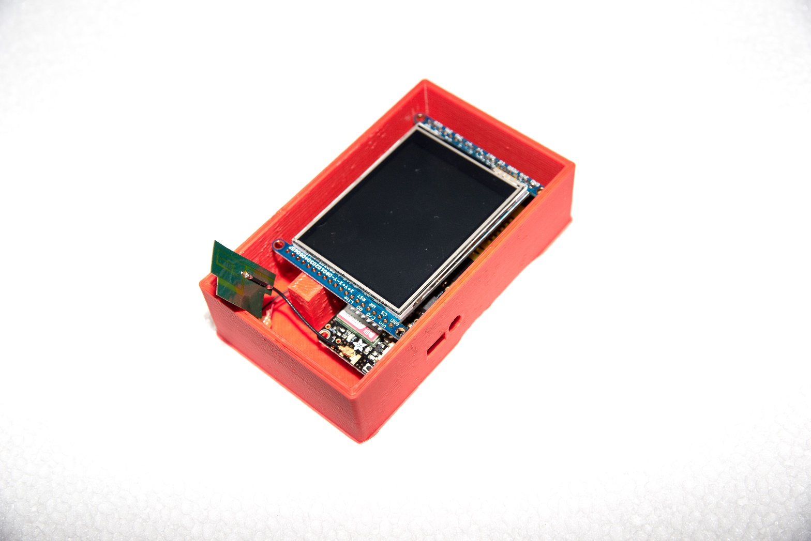
Target

Slide 3
Components
Arduino uno 8bit
Adafruit 2.8” tft touchscreen
Adafruit fona gsm-module
Cables
1cell 2000mAh Li-Po battery
Headset with microphone

Slide 4
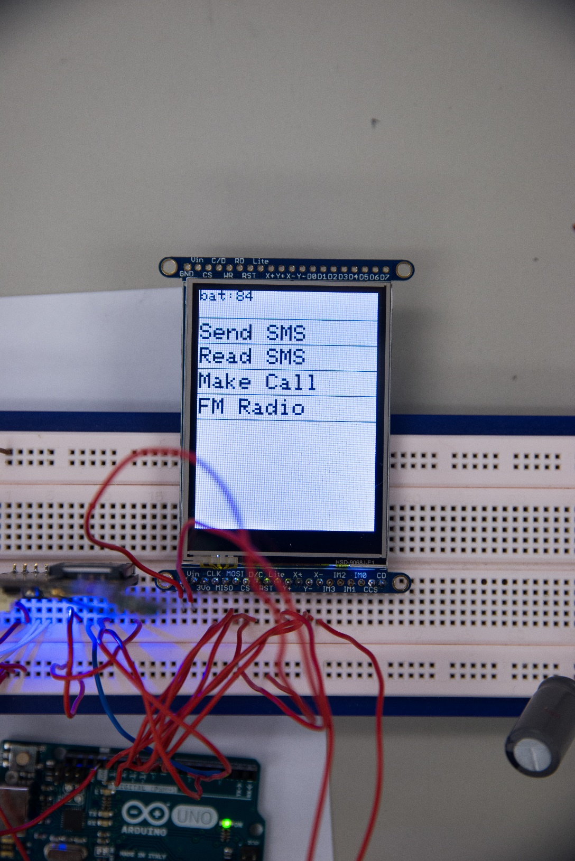

Slide 5
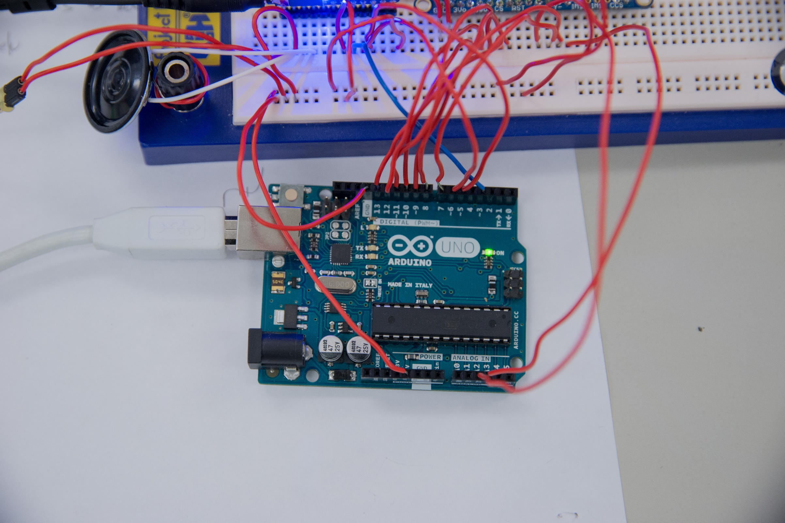

Slide 6
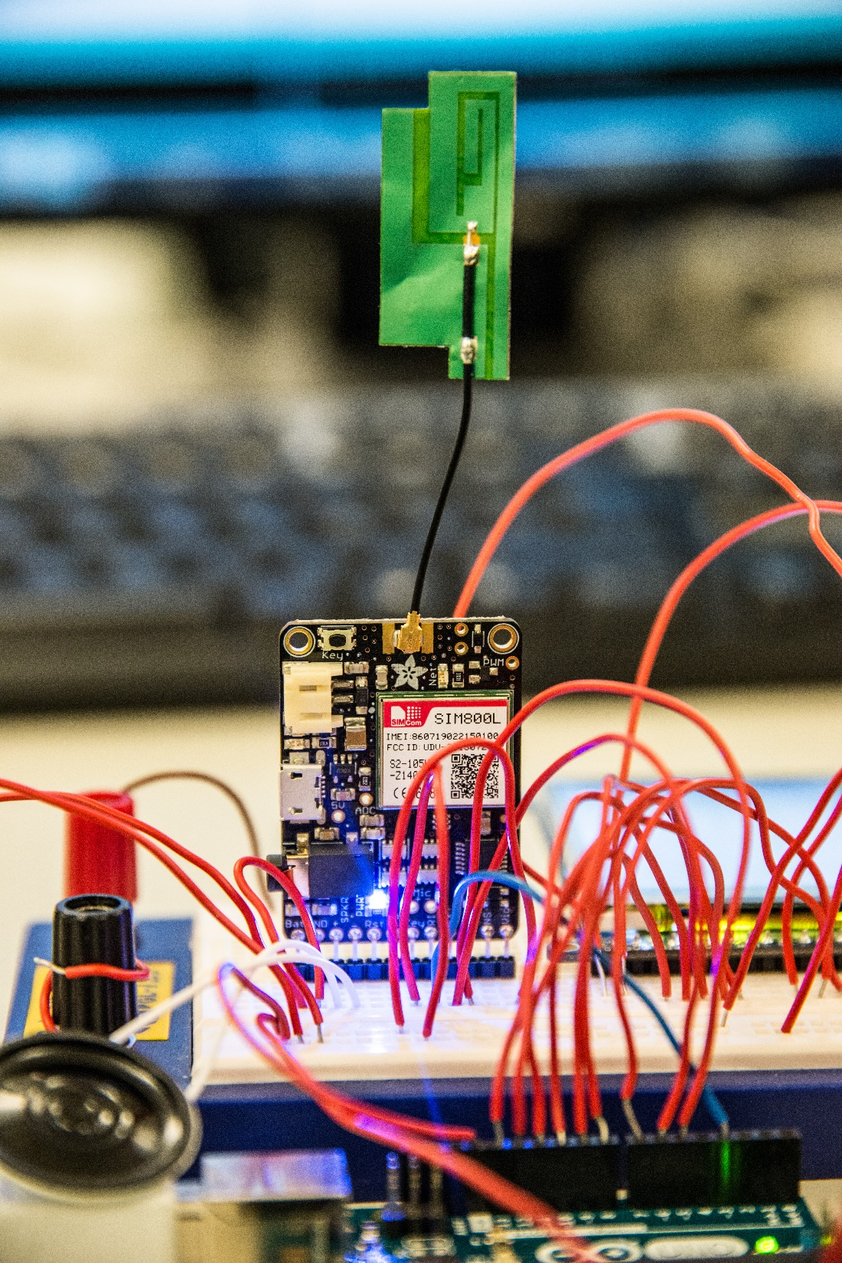

Slide 7
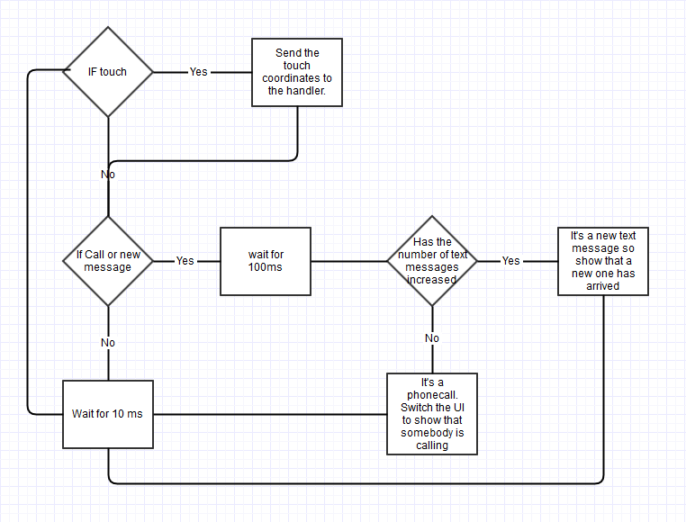
Main logic

Slide 8
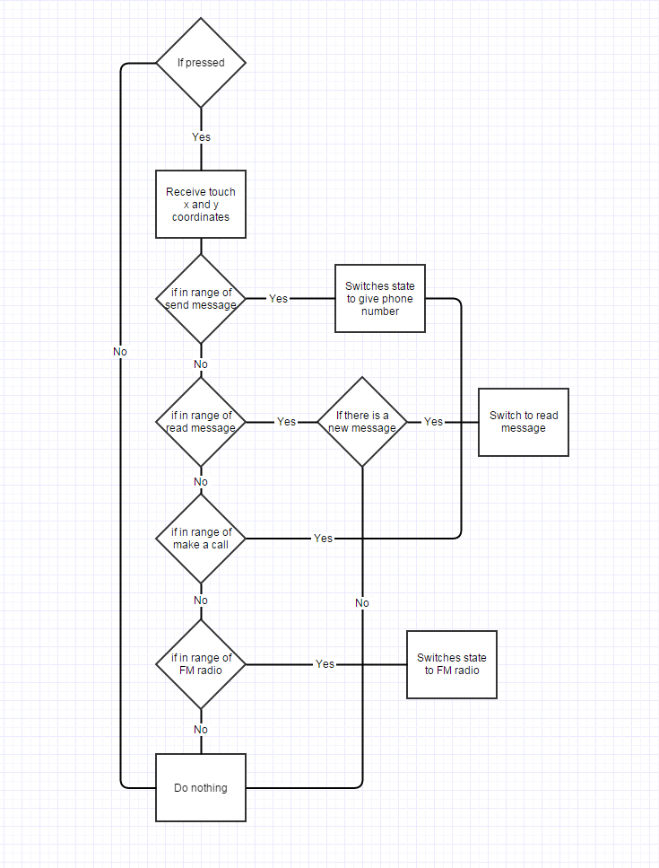
Main menu

Slide 9
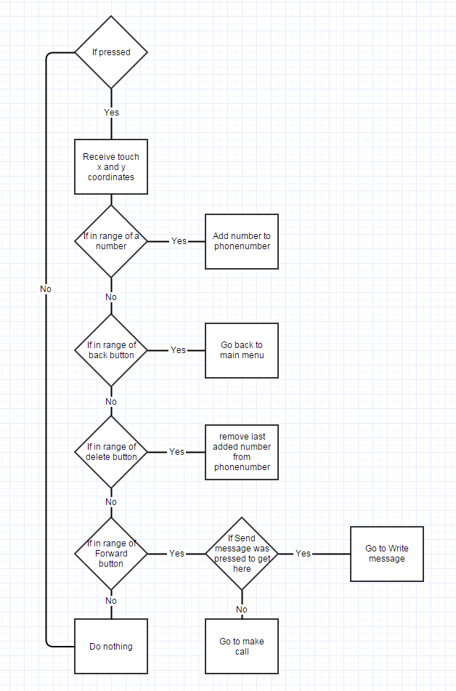
Give number

Slide 10
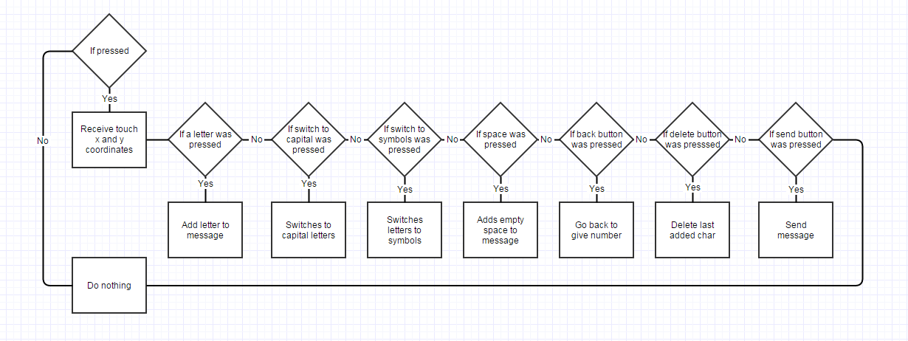
Send message

Slide 11
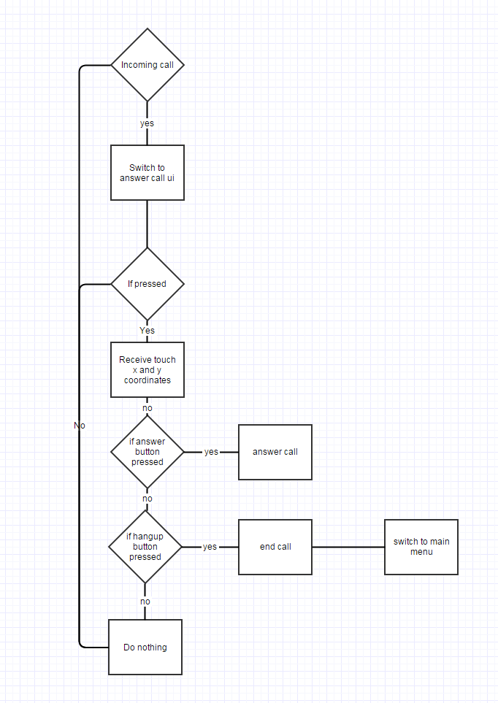
Phone call

Slide 12
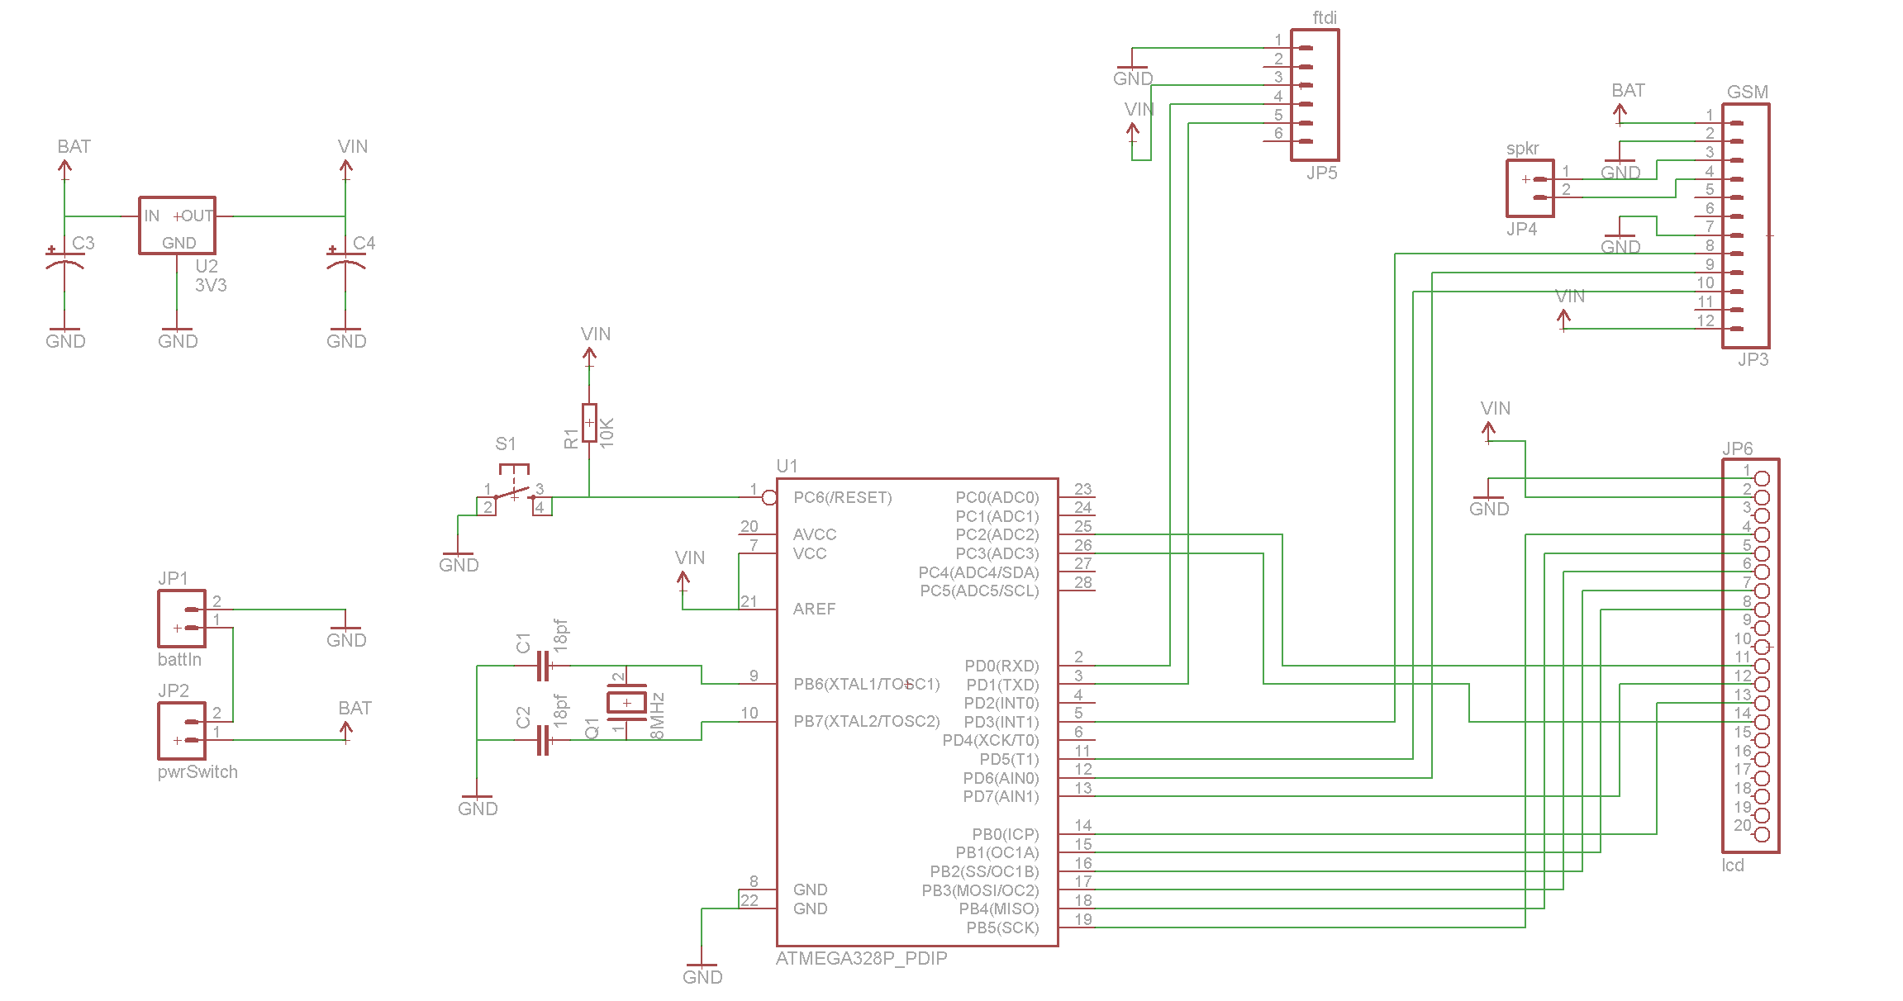
”Mokia” mode

Slide 13
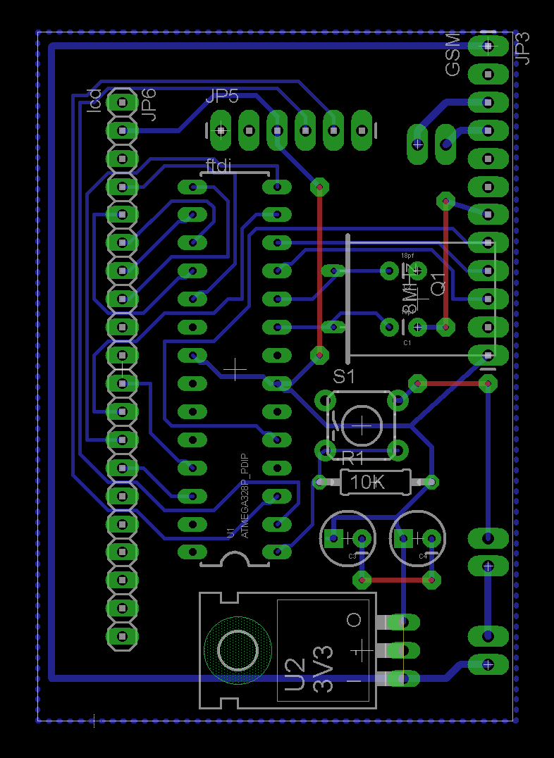

Slide 14
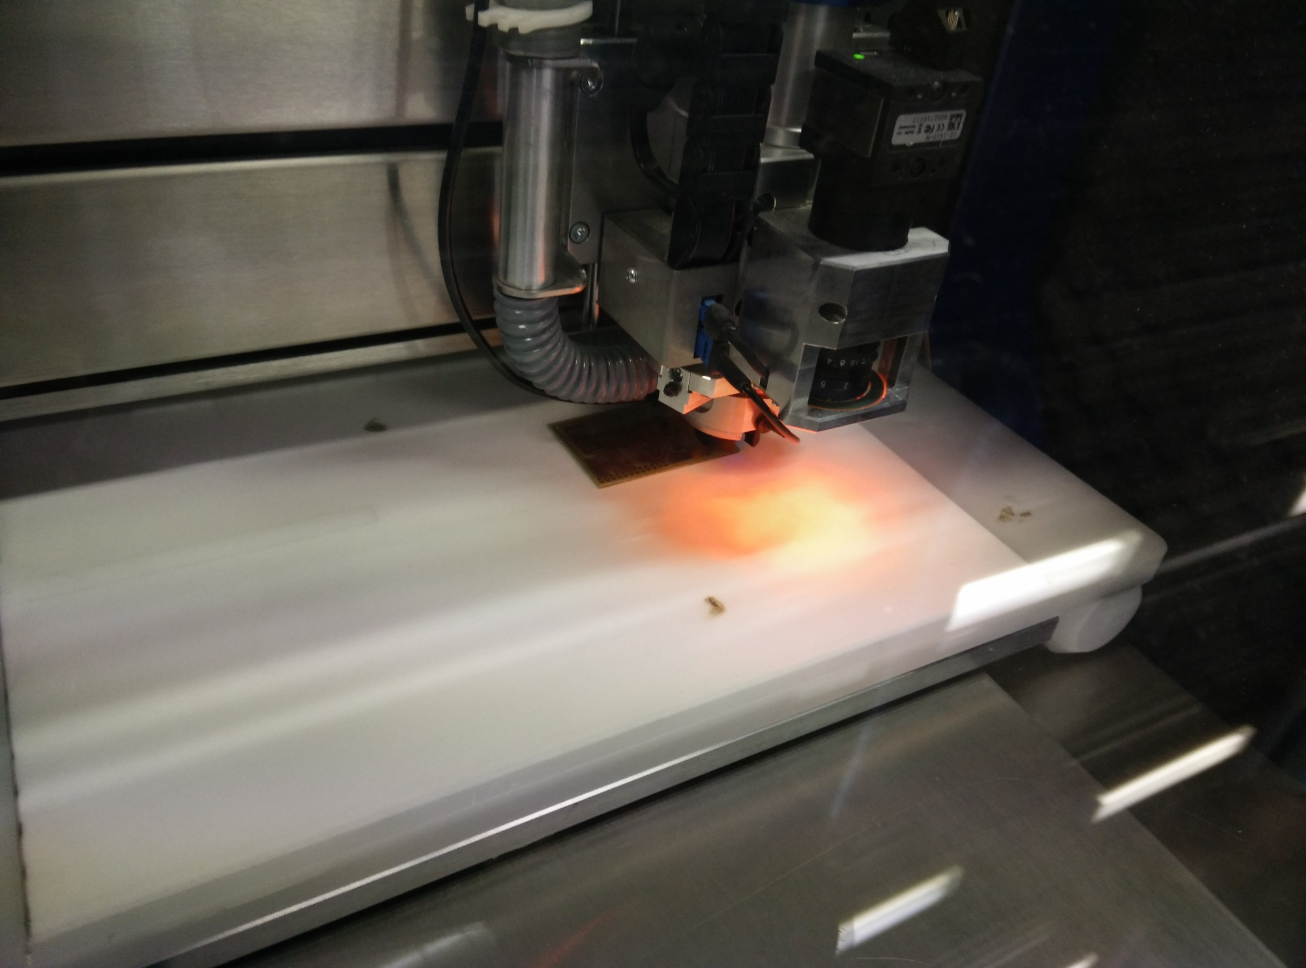

Slide 15
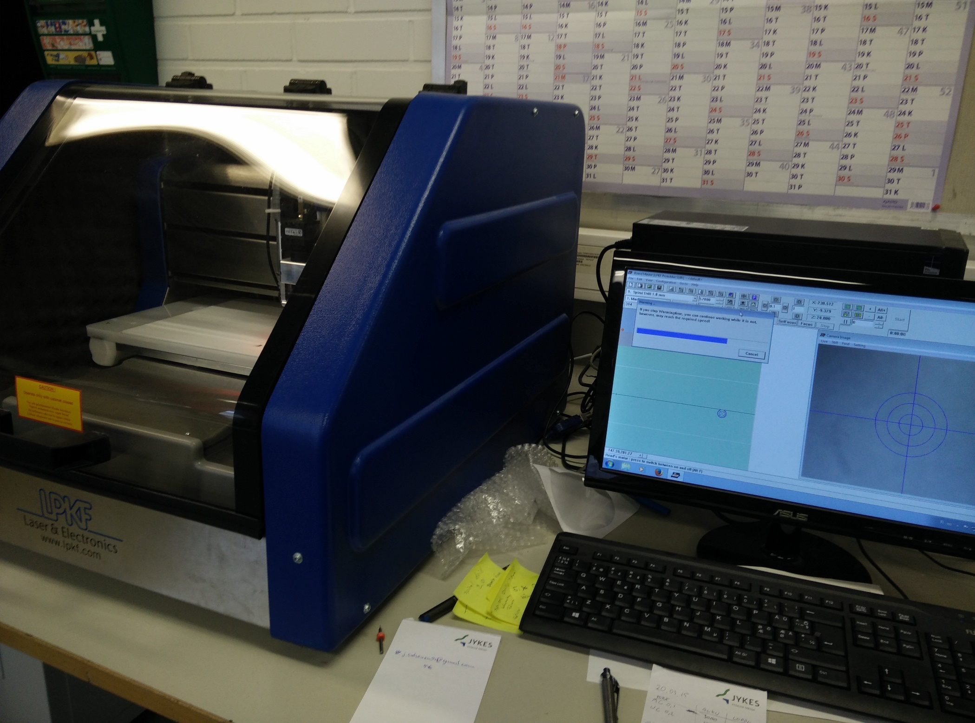

Slide 16
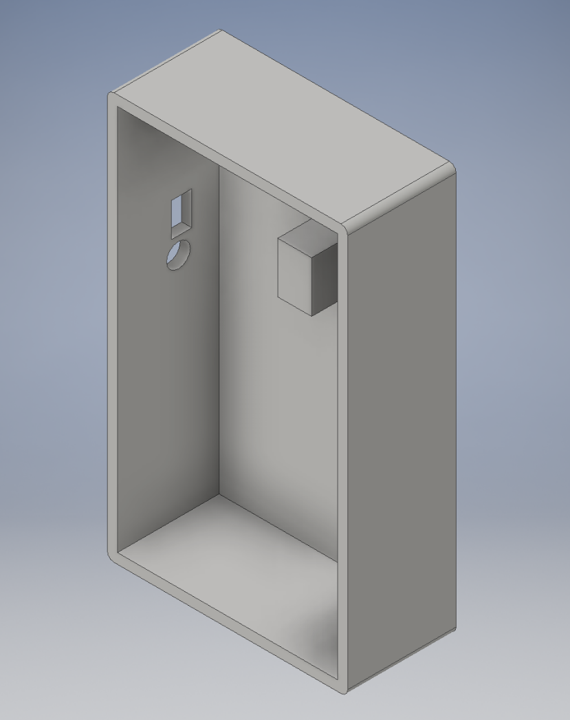

Slide 17
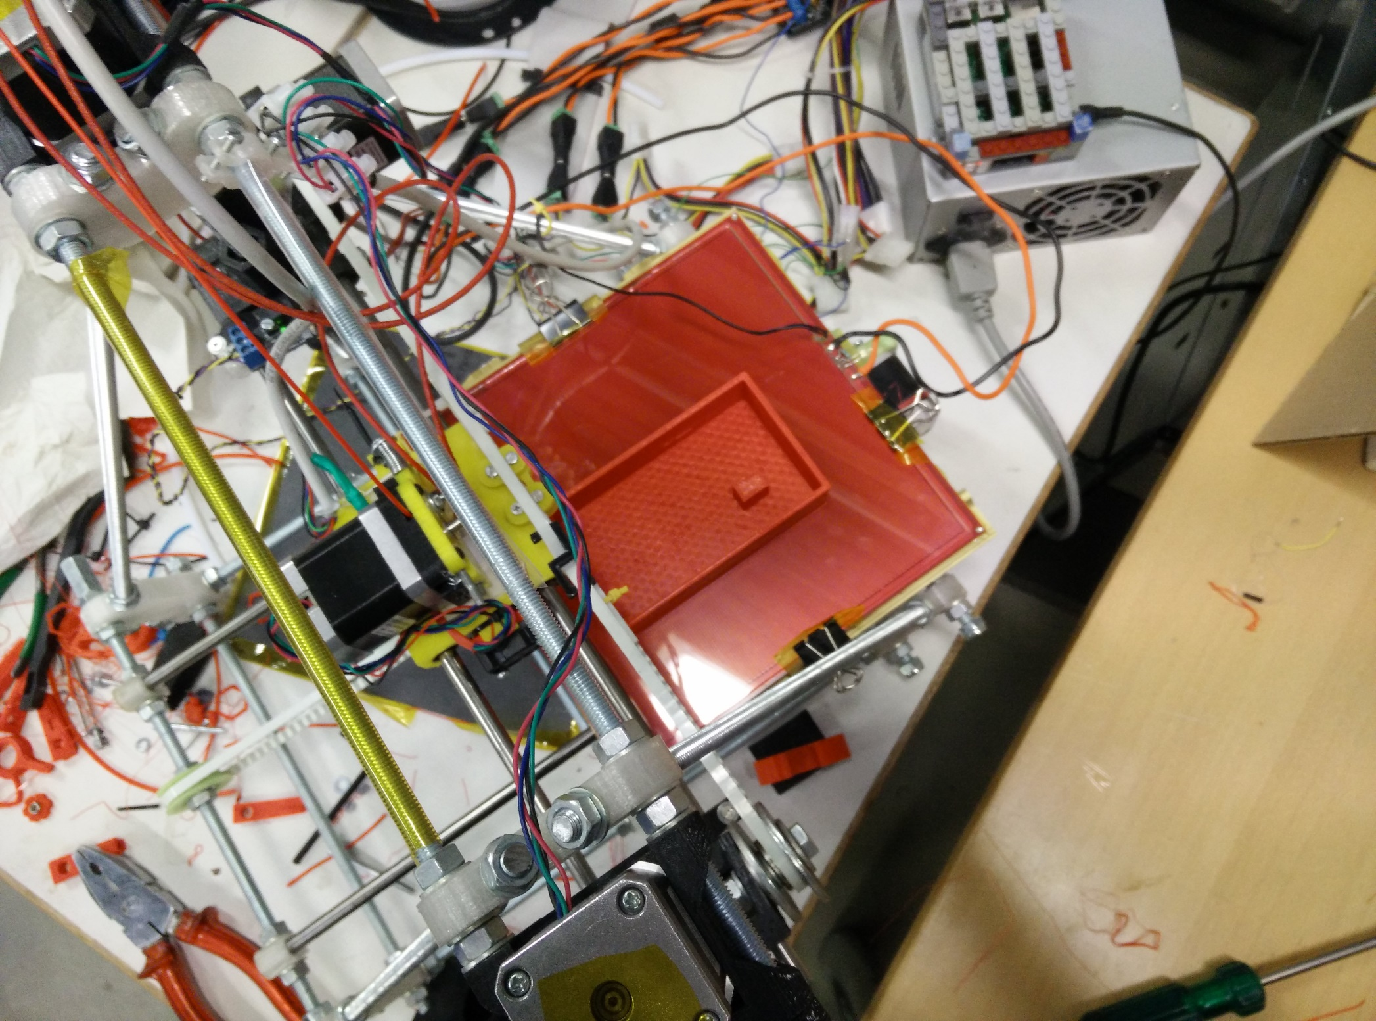

Slide 18
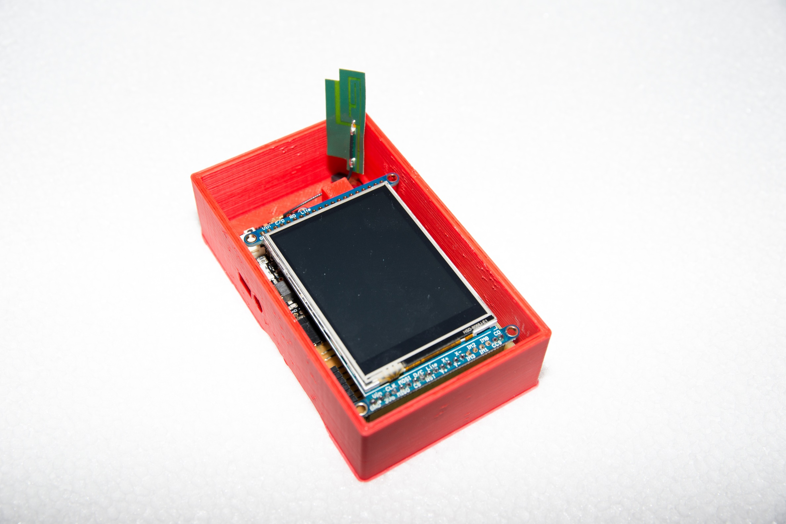

Slide 19
Demo time

Slide 20
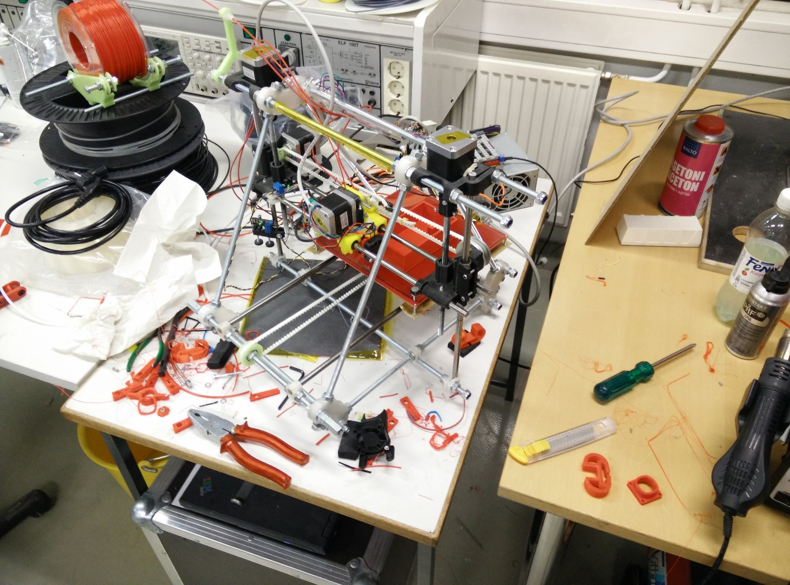
Questions?

